Slide 1
ANL201 – Study Units
Time frame and Deliverables
Study Unit | Topic | Date (2021) | Quiz | Deadlines
1 | Business Performance Management Balanced Scorecard Strategy Map | 4th Feb | Pre-Course Quiz 01* | 25th Jan – 5th Feb
2 | All about Data | 6th Feb | Pre-Class Quiz 01* | 8th Feb – 15th Feb
 |  |  | Tutor Marked Assignment | 17th Feb (by 2355 hrs)
3 | Theory/ Foundation to Visualization | 18th Feb | Pre-Class Quiz 02* - | 22nd Feb – 1st Mar -
4 | Basic Visualization | 25th Feb
5 | Advanced Visualization | 4th Mar | Group Based Assignment | 3rd Mar (by 2355 hrs)
6 | Business Performance Dashboard | 11th Mar | End of Course Assessment | 18th Mar (by noon)
*All quizzes have a 12-NOON deadline. No extensions!

Slide 2
Learning Objectives of ANL201
By the end of this Course
Understand concepts of Business Performance, Measurement, Balanced Scorecard Model and Data Visualization
Compare stages of Data Visualization Process
Data Visualization Components
Design Principles of a Business Performance Dashboard
Appropriateness of Data Visualization techniques based on available data
Appropriates of Business Performance Measure against Business Strategy of Organization
Required Textbooks:
Yau, N,.(2013). Data Points: Visualization that Means Something
Murray, D. G. (2013). Tableau Your Data

Slide 3
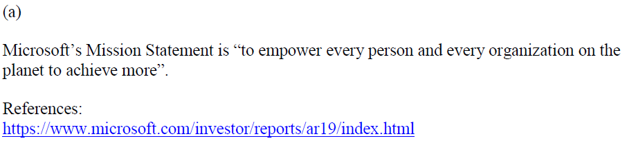
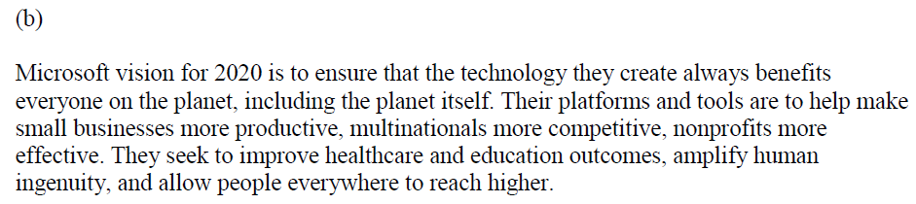
TMA IDEAL Solutions

Slide 4
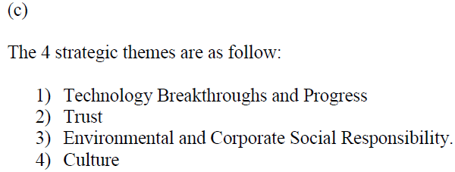
TMA IDEAL Solutions

Slide 5
Visualisation for Business ANL 201
Basic Data Visualisation Techniques Study Unit 4
January 2021

Slide 6
Visualisation of Categorical Data

Slide 7
Visualisation of Categorical Data
Best practices for visualising categorical data
With categorical data, we often look for both maximum and minimum values because they give us a sense of the data range, and they can be easily found by sorting the values
Next we look at the distribution of the data, i.e., whether it is positively skewed, negatively skewed, or normally distributed
Finally, we look for structure and patterns. If several categories have similar/different values, it is worth asking why and what makes the categories similar or different

Slide 8
Visualisation of Categorical Data
Visualising categorical data
Bar / Stacked Bar Chart
Side-by-side Bar Chart
Pie Chart
Area Chart
Heat Map
Tree Map

Slide 9
Visualisation of Categorical Data
Qn: What does the data trend look like?
Dataset
1 | 3 | 2 | 4
1 | 3 | 3 | 5
1 | 2 | 3 | 2
5 | 2 | 1 | 2
7 | 4 | 2 | 7
Maximum = 1
Minimum = 7
Mean = 2.79
Median = 2.00
Mode = 2.00
Data
Exploration
For categorical data, the sum of the parts = whole.
Therefore, it lends itself easily to proportional measurements
Interval | Frequency
0 to 1 | 4
1 to 2 | 6
2 to 3 | 4
3 to 4 | 2
4 to 5 | 2
5 to 6 | 0
6 to 7 | 1
Dataset (Sorted)
1 | 2 | 3 | 4
1 | 2 | 3 | 5
1 | 2 | 3 | 5
1 | 2 | 3 | 7
2 | 2 | 4 | 7
Binning

Slide 10
Visualisation of Categorical Data
After you Explore your data
Frequency Distribution Tables
Bar Chart/ Stacked Bar Chart
Pie Charts
Pareto Diagrams
Each bar is category; y-axis is frequency (relative or absolute)
Used when we want to see share of an item as part of total
Categories shown in descending order of frequency, and separate curve shows cumulative frequency.

Slide 11
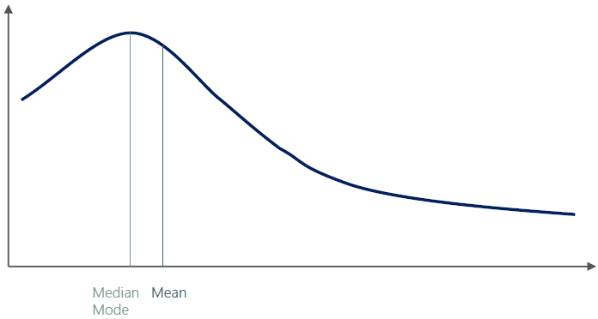
Visualisation of Categorical Data
What is skewness?
Measure of asymmetry that indicates whether the observations in a dataset are concentrated on one side
Right (positive) skewness - outliers are to the right (long tail to the right)
Left (negative) skewness - outliers are to the left

Slide 12
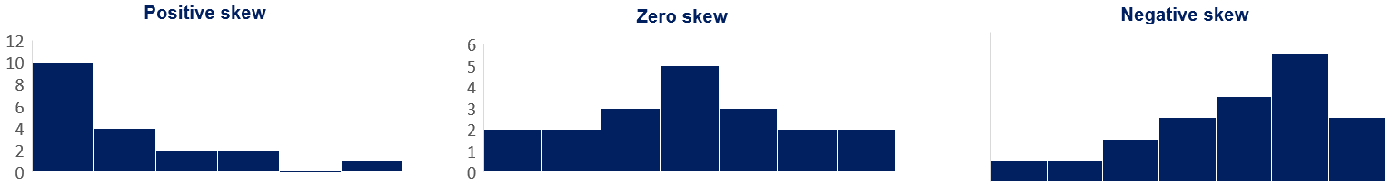
Visualisation of Categorical Data
Long tail to the right
(Close to) Symmetric
Long tail to the left

Slide 13
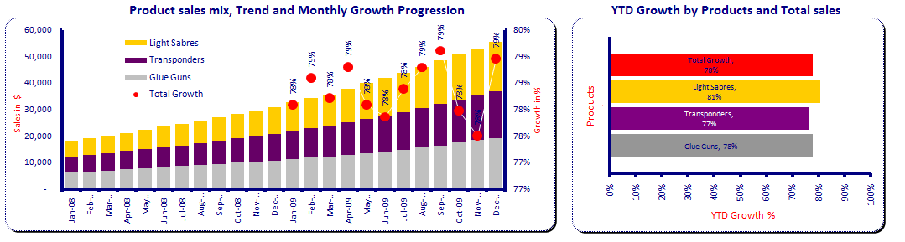
Visualisation of Categorical Data
Visualising categorical data — bar chart / stacked bar chart
Create a new worksheet.
Horizontal Bars - Drag one or more measures into the worksheet’s columns.
Vertical Bar - Drag one or more measures into the worksheet’s rows.
https://help.tableau.com/current/pro/desktop/en-us/buildexamples_bar.htm

Slide 14
Visualisation of Categorical Data
Visualising categorical data — side-by-side (i.e., grouped) bar chart
Drag two or more measures into either the worksheet’s columns or rows.
Measure Values and Measure Names will then be created automatically.
Measure Names and Measure Values can be used to express various measures in a data set or multiple measures on a single axis.
Measure Values contains the data while Measure Names is used to separate the bars used on the marks
https://kb.tableau.com/articles/howto/creation-of-a-grouped-bar-chart

Slide 15
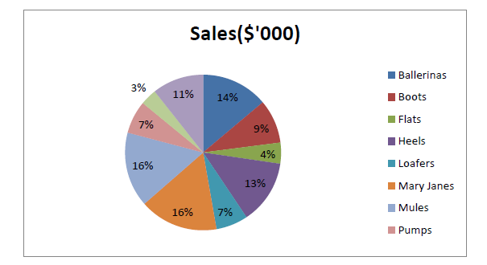
Visualisation of Categorical Data
Visualising categorical data — pie chart
Pie Chart should be used to get a general sense of magnitude, but not for precise comparisons.
A pie chart is limited by its area meaning that if you have many categories, you have many slivers and its hard to compare.
https://help.tableau.com/current/pro/desktop/en-us/buildexamples_pie.htm
Notes:
The result is a rather small pie. To make the chart bigger, hold down Ctrl + Shift (hold down ñ + z on a Mac) and press B several times.

Slide 16
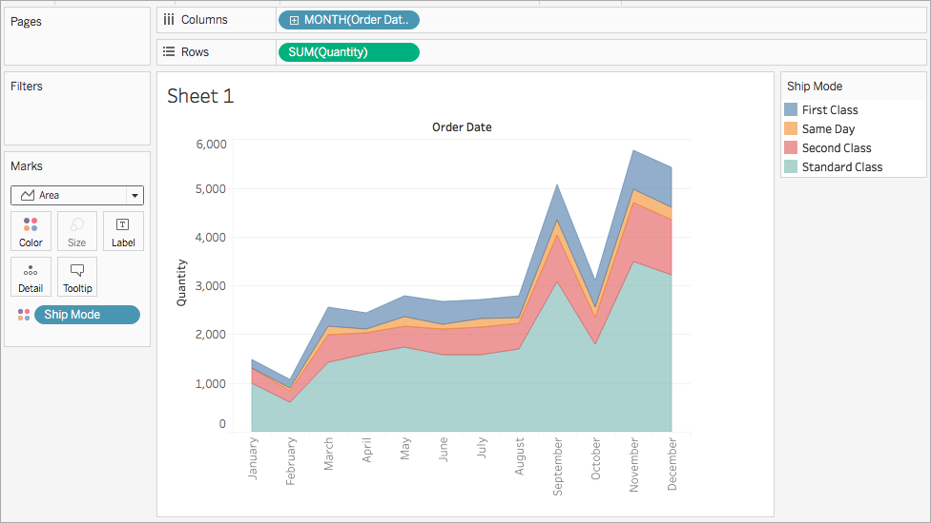
Visualisation of Categorical Data
Visualising categorical data — area chart
Area Fill chart plots values as bands, thus it is easy to misinterpret the top band as being the largest value in a data set.
The Area Fill Chart is best used to plot a single dimension to avoid such misinterpretation.
https://help.tableau.com/current/pro/desktop/en-us/qs_area_charts.htm

Slide 17
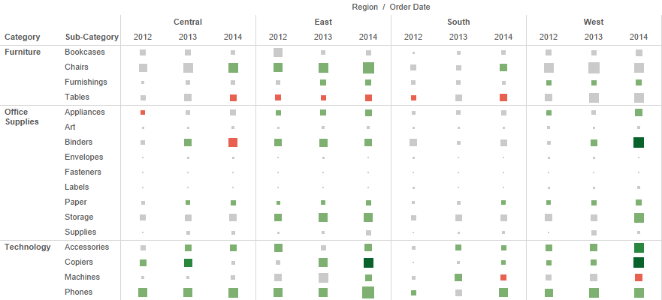
Visualisation of Categorical Data
Visualising categorical data — heat map
Heat Maps use colours and sizes to compare up to two measures.
https://help.tableau.com/current/pro/desktop/en-us/buildexamples_highlight.htm

Slide 18
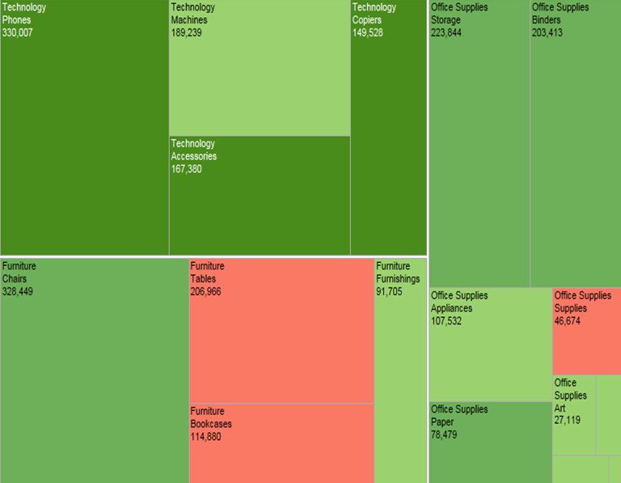
Visualisation of Categorical Data
Visualising categorical data — tree map
Treemaps effectively display larger dimension sets using colours and sizes to display one or more dimensions, and up to two measures.
https://help.tableau.com/current/pro/desktop/en-us/buildexamples_treemap.htm

Slide 19
Visualisation of Time Series Data

Slide 20
Visualisation of Time Series Data
Discrete (bucketed) time series data
Discrete time series data values are from specific points or blocks of time, and there is a finite number of possible values
A line chart is the most effective way to display time series data. A line chart for discrete time series data places breaks between time units like year, quarter, month and day
Bar, stacked bar charts, and scatterplots can also be used to display time series data
The power of “Time Series Analysis” lies in looking for trends in temporal data and forecasting i.e., based on what I see in the past, can I predict the future? Is this pattern seasonal/cyclical?
A whole picture view is more important than the individual data points

Slide 21
Visualisation of Time Series Data
Continuous (unbroken) time series data
Visualising continuous time series data is similar to visualising discrete time series data. We still have a discrete number of data points, even if the dataset is continuous
Line chart for continuous time series data is presented as unbroken lines
Step charts are appropriate if the measure stays at a value for a long time and all of a sudden declines or inclines
Trendlines are useful in the presence of noisy data or large amounts of data
Notes:
A Step chart is a Line chart that does not use the shortest distance to connect two data points. Instead, it uses vertical and horizontal lines to connect the data points in a series forming a step-like progression. The vertical parts of a Step chart denote changes in the data and their magnitude. The horizontal parts of a Step chart denote the constancy of the data.

Slide 22
Visualisation of Time Series Data
Visualising time series data
Powerful Story Telling Tool – Crude Price & History
Line Chart
Sparkline Chart
Gantt Chart
Trendline
Reference Line

Slide 23
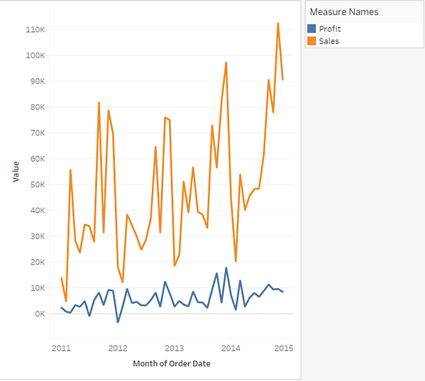
Visualisation of Time Series Data
Visualising time series data – line chart
Useful for data that does not stay constant i.e., is variable.
Data that stays constant, then suddenly changes, then stays constant etc is better visualized with a “step” graph
Data that is TOO highly variable (noisy data) sometimes needs to be smoothed and/or a “trend line” can be applied to make sense of it
https://help.tableau.com/current/pro/desktop/en-us/buildexamples_line.htm

Slide 24
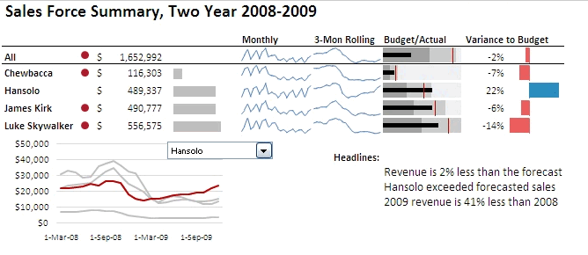
Visualisation of Time Series Data
Visualising time series data – sparkline chart
Information is displayed in a compact manner. However, this is a difficult plot style to grasp. Each element must be explained, and the audience needs to be guided
https://kb.tableau.com/articles/howto/creating-sparklines
Notes:
A sparkline is a very small line chart, typically drawn without axes or coordinates. It presents the general shape of the variation (typically over time) in some measurement, such as temperature or stock market price, in a simple and highly condensed way. Sparklines are small enough to be embedded in text, or several sparklines may be grouped together as elements of a small multiple. Whereas the typical chart is designed to show as much data as possible, and is set off from the flow of text, sparklines are intended to be succinct, memorable, and located where they are discussed.
Remember, sparklines are not quite like regular charts or graphs in that they are meant to provide quick trends at a glance. They don’t usually contain typical context, such as the axis values.

Slide 25
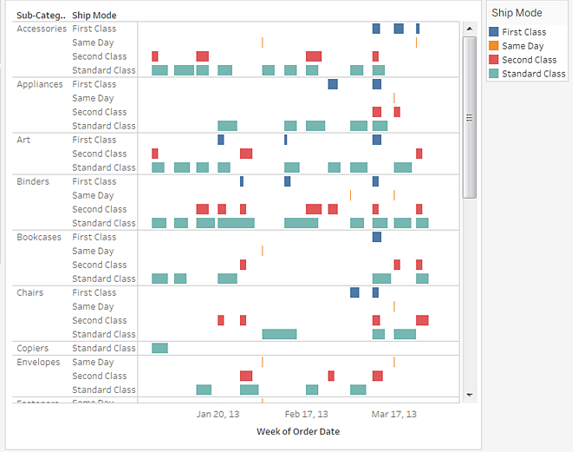
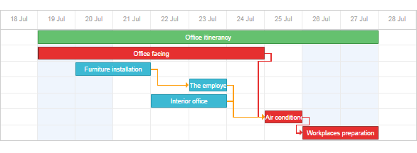
Visualisation of Time Series Data
Visualising time series data — gantt chart
Great project managing tool; has duration information and events/resources are visualized as bars. The physical position of the bars denotes start and end time; length is (obviously) duration.
Gantt charts also allow you to trace the “critical path”. Critical path analysis shows the sequence of scheduled tasks that determine the duration of a project. A critical path analysis identifies which tasks you must complete in order to meet your project deadline.
https://help.tableau.com/current/pro/desktop/en-us/buildexamples_gantt.htm
Notes:
Use Gantt charts to show the duration of events or activities.
In a Gantt chart, each separate mark (usually a bar) shows a duration. For example, you might use a Gantt chart to display average delivery time for a range of products.
The Gantt Chart is commonly being used in project planning. Activity or event start time is visualised by the bar’s horisontal position, and the duration of each activity or event is visualised by the individual bar length. Thus, this chart will be useful to visualise the timing and duration of activities or events.

Slide 26
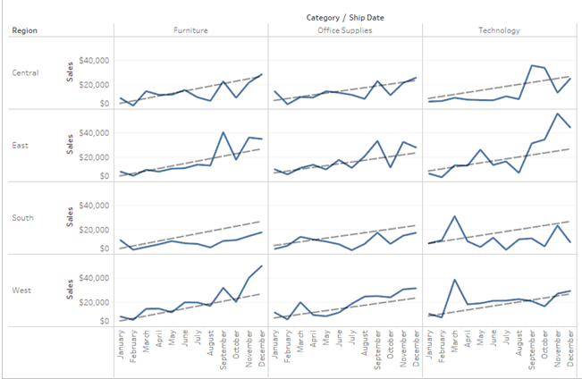
Visualisation of Time Series Data
Visualising time series data — adding a trend line
https://help.tableau.com/current/pro/desktop/en-us/trendlines_add.htm
Notes:
The Trend Line can help us see patterns that can provide predictive value, by drawing a line that best fits the values in the visualisation.
When we try to visualise granular data, sometimes it results in random looking Data Visualisation. The Trend Line can help us see patterns that can provide predictive value, by drawing a line that best fits the values in the visualisation.

Slide 27
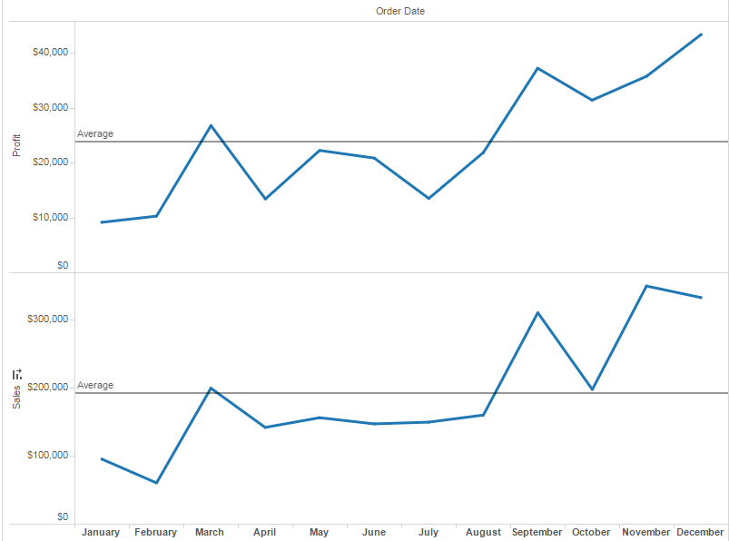
Visualisation of Time Series Data
Visualising time series data — adding a reference line/band/distribution/boxes
https://help.tableau.com/current/pro/desktop/en-us/reference_lines.htm
Notes:
The Reference Line can help us compare the actual data presented in the visualisation against targets, create statistical analyses of the deviation contained in the visualisation, or create the range of values based on fixed or calculated numbers.
The Reference Line can help us compare the actual data presented in the visualisation against targets, create statistical analyses of the deviation contained in the visualisation, or create the range of values based on fixed or calculated numbers. By looking at the Reference Line, we will be able to identify outliers that may require our attention or additional analysis.

Slide 28
Discussion
Can you name some of the time series data that an organization (lets assume it’s Amazon Prime) will normally want to visualise?
Notes:
Some of the possible solutions include:
revenue, profit, cost: bar charts
Share price: line charts
Customer demographics: pie charts

Slide 29
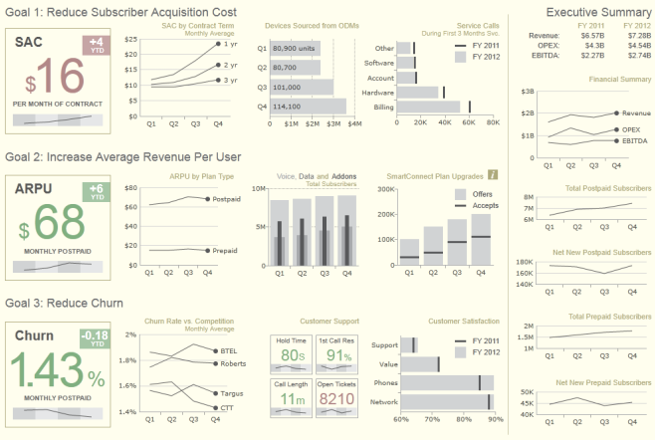
Discussion
Can you name some of the time series data that an organisation will normally want to visualise?
Source: http://dashflows.com/ww2/wp-content/uploads/2014/11/CTT-Wireless.png
Notes:
Some of the possible solutions include:
revenue, profit, cost: bar charts
Share price: line charts
Customer demographics: pie charts

Slide 30
Tableau (Class Activity)
(15 min break)

Slide 31
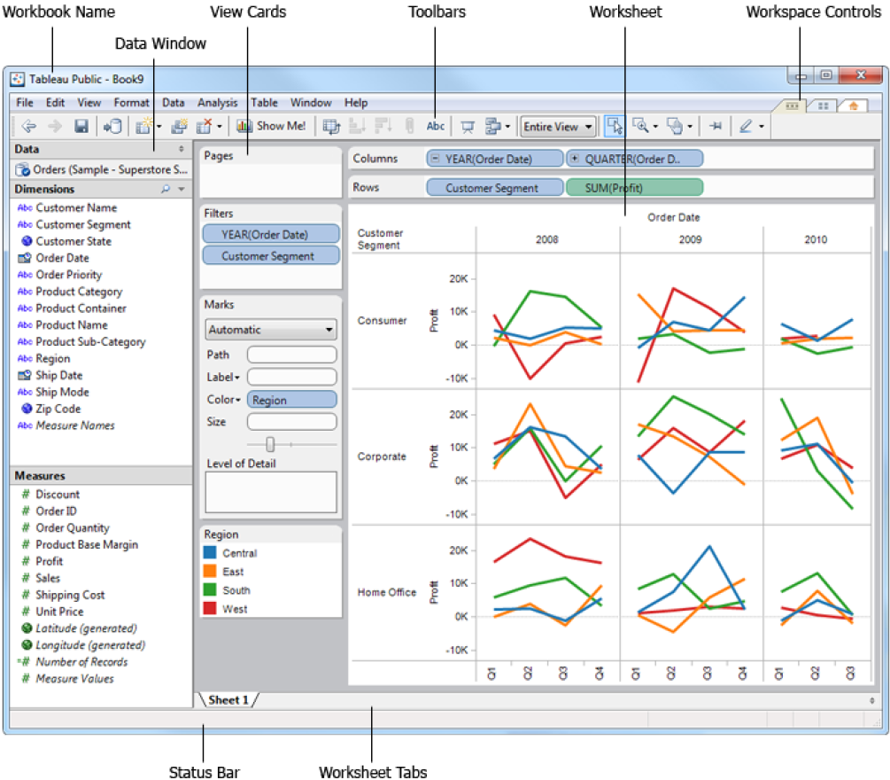
Notes:
Let the students know that is always a good practice to visualise the chart that they want to have for a report or dashboard before they start creating the report or dashboard.
The result is a rather small pie. To make the chart bigger, hold down Ctrl + Shift (hold down ñ + z on a Mac) and press B several times.
Use Global Superstore 2016 – Order Data [Filter at the Data Source only US]
Do a brief recap on how to load the data into Tableau. Tableau will auto detect whether the variable is a measure or dimension but is always to run through to ensure that is correctly assigned.
Tell the students that is a good practice to name the worksheet, give a title and show the caption. Tableau uses one worksheet per chart.
Simple Report – Sum of profit by region and customer segment
Note to students that the measure can be changed from sum to average, median, count, count(distinct)
2. Two Measures Report – Break down sum and average of profit by product category
3. Pie Chart – Use customer segment for colour of the pie, sum of profit for size and angle, show the segment name using label and show the % of the segment using label as well. To show % of the segment, go to Analysis and check Table under Percentage of. Explain the pie chart briefly such as consumer segment is the largest segment at 46.83% followed by Corporate at 32.12%.

Slide 32
Tableau (Class Activity)
Sit with your GBA’s team mates
Follow your instructor to create the followings:
Simple report
Two measures report
Pie chart
Bar chart with reference line
Stacked bar chart
Line chart with trend line
Line chart with 2 axis
Area chart
Bullet chart
Gantt chart
Heat Map

Slide 33
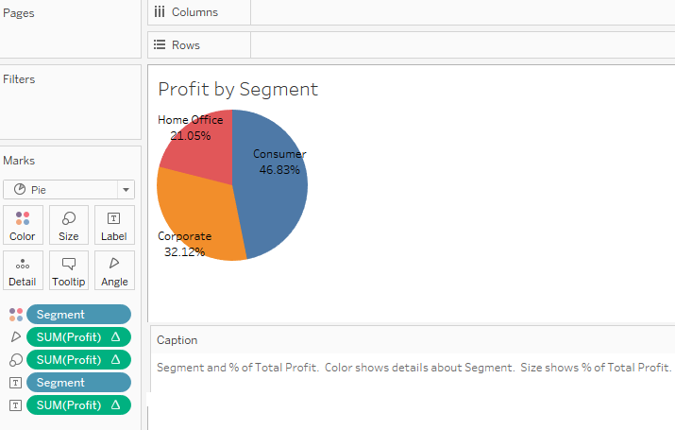
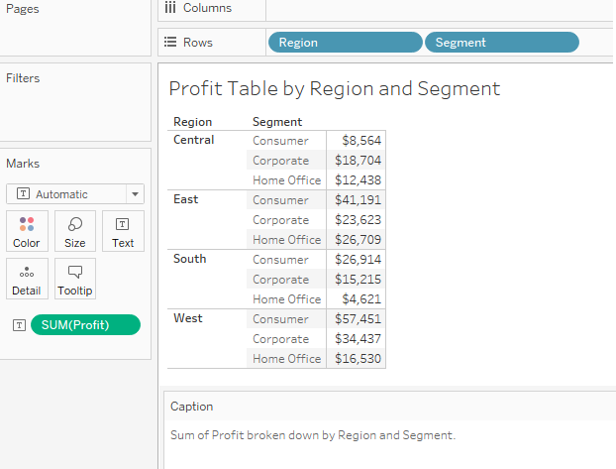
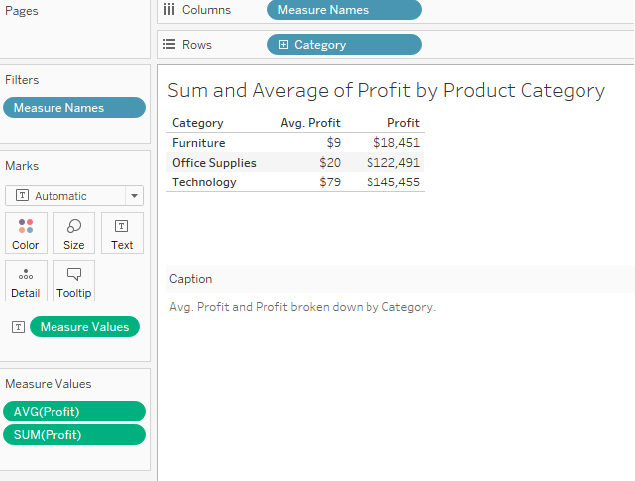
Tableau (Class Activity)
Simple Report
Pie Chart
Two-Measures Report
Notes:
Let the students know that is always a good practice to visualise the chart that they want to have for a report or dashboard before they start creating the report or dashboard.
The result is a rather small pie. To make the chart bigger, hold down Ctrl + Shift (hold down ñ + z on a Mac) and press B several times.
Use Global Superstore 2016 – Order Data [Filter at the Data Source only US]
Do a brief recap on how to load the data into Tableau. Tableau will auto detect whether the variable is a measure or dimension but is always to run through to ensure that is correctly assigned.
Tell the students that is a good practice to name the worksheet, give a title and show the caption. Tableau uses one worksheet per chart.
Simple Report – Sum of profit by region and customer segment
Note to students that the measure can be changed from sum to average, median, count, count(distinct)
2. Two Measures Report – Break down sum and average of profit by product category
3. Pie Chart – Use customer segment for colour of the pie, sum of profit for size and angle, show the segment name using label and show the % of the segment using label as well. To show % of the segment, go to Analysis and check Table under Percentage of. Explain the pie chart briefly such as consumer segment is the largest segment at 46.83% followed by Corporate at 32.12%.

Slide 34
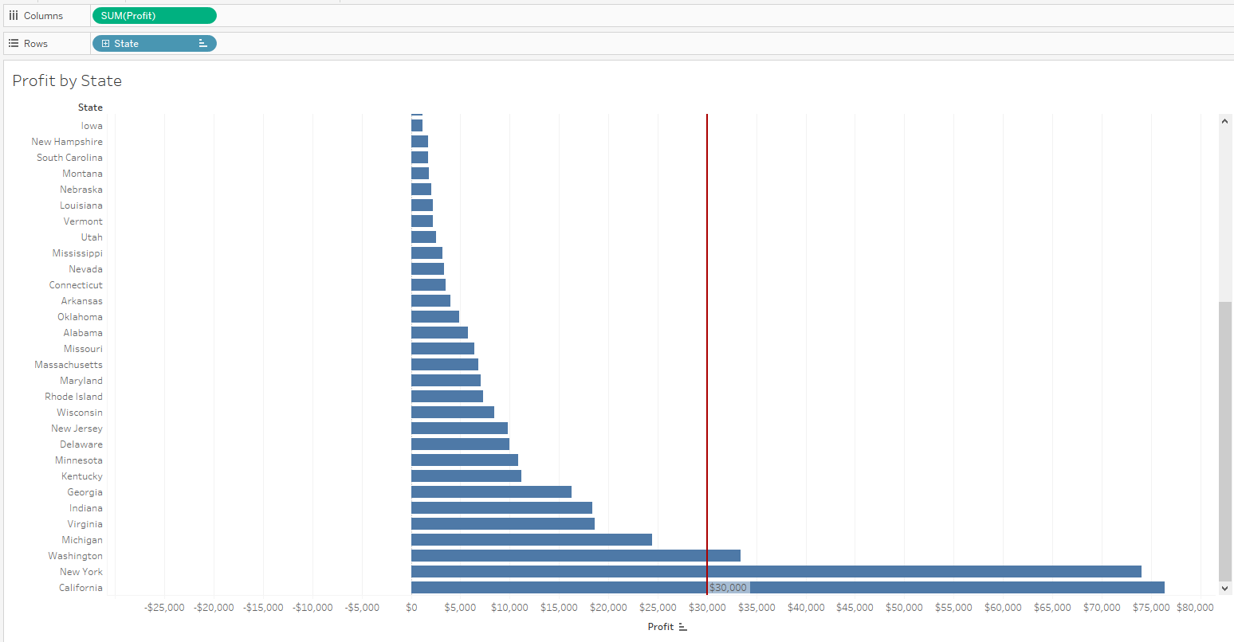
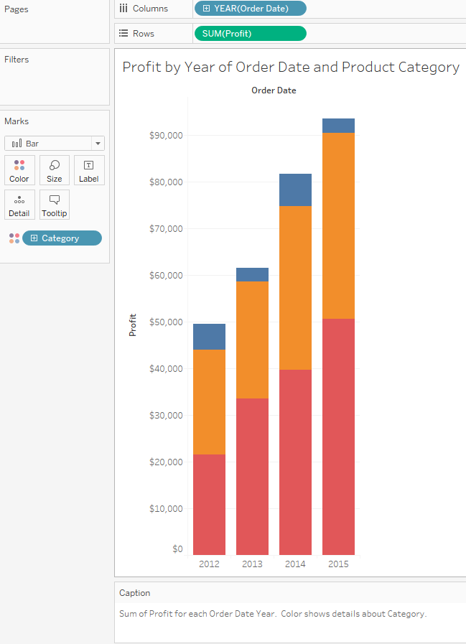
Tableau (Class Activity)
Bar Chart with reference line
Stacked Bar Chart
Notes:
4. Bar Chart with reference line– Set Sum(Profit) to be column and State to be Rows. Sort the profit ascending. Create a reference at 30,000 (Right Click at Axis) and change the colour to red. Explain the reference line. Show the students that the row and col can be swapped. Explain the chart briefly.
5. Stacked Bar Chart – Set Year of Order Date to be column and Sum(Profit) to be Rows, set product category to be the colour of the stack. Explain that Tableau will usually plot the highest order of date which is year and drill down to show quarters and months. Explain the chart briefly.

Slide 35
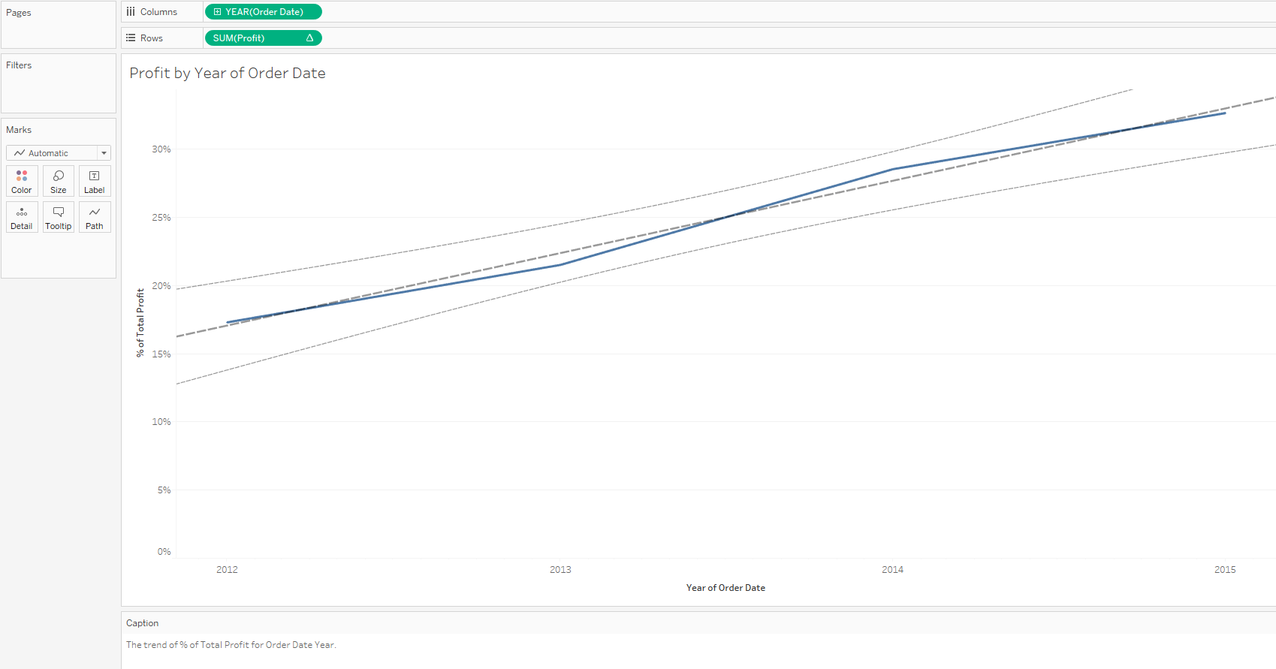
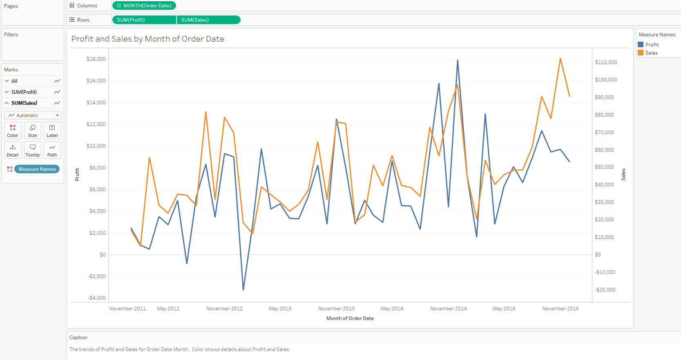
Tableau (Class Activity)
Line Chart with trend line
Line Chart with 2 Y-axis
Notes:
6. Line Chart with trend line – Set Year of Order Date to be column and Sum(Profit) to be Rows. Create the trend line and explain the trend line. Explain the chart briefly. (Right Click on Trend Line)
7. Line Chart with 2 Y-axis - Set Year of Order Date to be column and Sum(Profit) and sum(Sales) to be Rows. Put Measures name as colour. Explain the chart briefly. Right click the sales-axis, select dual axis.
The T distribution, also known as the Student's t-distribution, is a type of probability distribution that is similar to the normal distribution with its bell shape but has heavier tails. T distributions have a greater chance for extreme values than normal distributions, hence the fatter tails.
The null hypothesis states that there is no relationship between the two variables being studied (one variable does not affect the other). It states the results are due to chance and are not significant in terms of supporting the idea being investigated. Thus, the null hypothesis assumes that whatever you are trying to prove did not happen.
The level of statistical significance is often expressed as a p-value between 0 and 1. The smaller the p-value, the stronger the evidence that you should reject the null hypothesis.
A p-value less than 0.05 (typically ≤ 0.05) is statistically significant. It indicates strong evidence against the null hypothesis, as there is less than a 5% probability the null is correct (and the results are random). Therefore, we reject the null hypothesis, and accept the alternative hypothesis.
However, this does not mean that there is a 95% probability that the research hypothesis is true. The p-value is conditional upon the null hypothesis being true is unrelated to the truth or falsity of the research hypothesis.
A p-value higher than 0.05 (> 0.05) is not statistically significant and indicates strong evidence for the null hypothesis. This means we retain the null hypothesis and reject the alternative hypothesis. You should note that you cannot accept the null hypothesis, we can only reject the null or fail to reject it.
A statistically significant result cannot prove that a research hypothesis is correct (as this implies 100% certainty).
Instead, we may state our results “provide support for” or “give evidence for” our research hypothesis (as there is still a slight probability that the results occurred by chance and the null hypothesis was correct – e.g. less than 5%).

Slide 36
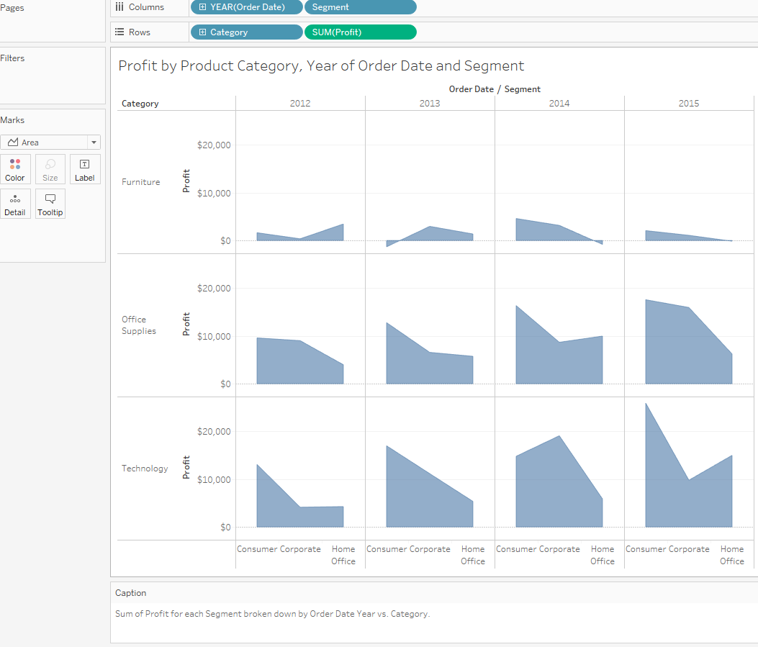
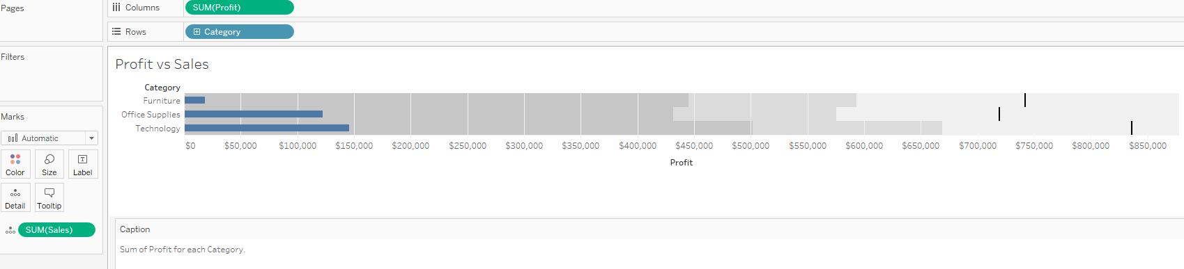
Tableau (Class Activity)
Area Chart
Bullet Chart
Notes:
8. Area Chart – Set Year of Order Date and customer segment to be column and product category and Sum(Profit) to be Rows. Explain the chart briefly.
9. Bullet Chart – Bullet chart is usually created to compare actual with target. For this dataset, we will compare profit with sales. Set sum(profit) to be column and product category to be rows. Set sum(sales) as detail. Explain to the students that the reference lines can be swapped and edit. Explain the chart briefly. Bring in Sales and Profit, then click on Bullet chart], then bring in Category

Slide 37
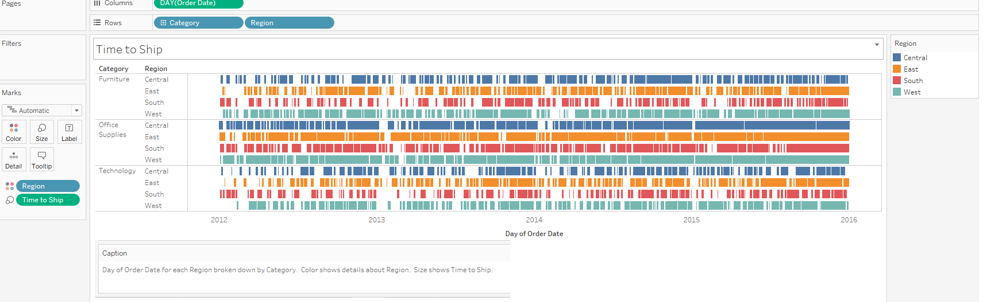
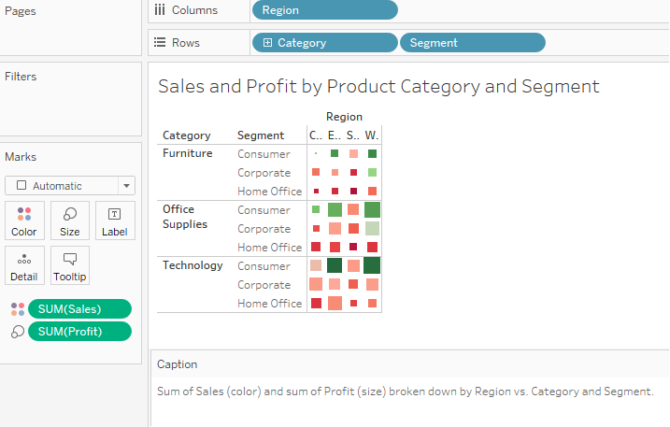
Tableau (Class Activity)
Gantt Chart
Heat Map
Notes:
10. Gantt Chart – Uncheck Aggregate measures and explain why this need to be done. Create a calculated field, Time to Ship which is ship date – order date. Set Day of Order Date to be column and product category and region to be Rows. Set colour to be region and size to Time to Ship. Explain the chart briefly.
11. Heat Map - Set region to be column and product category and customer segment to be Rows. Set colour to be sum(sales) and size to sum(Profit). Explain the chart briefly.

Slide 38
Course Homepage | https://canvas.suss.edu.sg/courses/31564
Study Guide | https://ibookstore.suss.edu.sg/
Tableau Desktop | https://www.tableau.com/products/trial
Tableau Tutorials | https://www.tableau.com/learn/get-started/creator
Academic Calendar | https://www.suss.edu.sg/docs/default-source/contentdoc/oas/pt-2021acadcalendar.pdf

Slide 39
Tableau Desktop System Requirements
Windows
Windows 7 or newer (64 bit)
Intel Pentium 4 or AMD Opteron processor or faster
2 GB memory
1.5 GB minimum free disk space
Mac
iMac/MacBook computers 2009 or newer
macOS High Sierra 10.13 and macOS Mojave 10.14
1.5 GB minimum free disk space
Notes:
Get licenses for students at https://www.tableau.com/academic/teaching/course-licenses

Slide 40
Tableau Prep Builder System Requirements
Windows
Windows 7 or newer (64 bit)
Intel Core i3 or AMD Ryzen 3 Pro or faster
4 GB memory
2 GB minimum free disk space
Mac
macOS High Sierra 10.13 and macOS Mojave 10.14
Intel Core i3 or faster
4 GB memory
2 GB minimum free disk space

